Slide 1
Building Retrieval-Augmented Generation (RAG) Agents with Large Language Models (LLMs) – Course Overview by NVIDIA Team
Explore cutting-edge AI techniques and practical applications
Notes:
AI-generated content may be incorrect. --- Welcome to this comprehensive course overview where we explore building Retrieval-Augmented Generation agents using large language models. This session is brought to you by the NVIDIA team, focusing on state-of-the-art techniques and practical implementations.

Slide 2
Course Agenda
Slide 1: Title – Introduction and Branding
Slide 2: Introduction to RAG Systems
Slide 3: Preparing the Environment
Slide 4: Understanding Large Language Models
Slide 5: Building a Simple RAG Agent
Slide 6: Improving Retrieval
Slide 7: Enhancing Generation
Slide 8: Grounding AI Responses
Slide 9: Importance of Veracity
Slide 10: Advanced Topics in RAG
Notes:
This course will cover key topics including RAG system fundamentals, environment setup, understanding large language models, building and improving RAG agents, grounding AI responses, veracity importance, and advanced topics in RAG techniques.

Slide 3
Slide 1: Title – Introduction and Branding
Notes:
We'll begin by presenting the course name along with NVIDIA branding to establish the course's identity. The slide incorporates an AI-themed visual and a modern, clean design to set the tone for the learning experience.

Slide 4

Course Name and NVIDIA Branding
Official Course Title
The slide prominently displays the official course title to clearly inform viewers about the presentation topic.
Branding Elements
Incorporating consistent branding elements enhances credibility and professionalism in the presentation's design.
Notes:
--- This content highlights the official course title and showcases NVIDIA's branding elements, reinforcing credibility and professionalism throughout the presentation. Image source: Microsoft 365 content library

Slide 5

AI-Themed Visual
Engaging Visual Element
The visual captures audience attention by representing AI concepts in a dynamic and appealing way.
Reflecting Course Focus
The image symbolizes artificial intelligence and machine learning technologies central to the course content.
Notes:
--- An AI-inspired visual element is used to engage the audience and reflect the course's focus on artificial intelligence and machine learning technologies. Image source: Microsoft 365 content library

Slide 6

Modern, Clean Design
Clarity and Simplicity
The design focuses on clear communication using simple and uncluttered visual elements.
Clean Lines and Spacing
Use of clean lines and adequate spacing creates an organized and balanced visual flow.
Notes:
--- The slide design emphasizes clarity and simplicity, using clean lines and spacing to maintain an organized and visually appealing layout. Image source: Microsoft 365 content library

Slide 7
Slide 2: Introduction to RAG Systems
Notes:
This section introduces the concept of Retrieval-Augmented Generation systems, discussing their definition, benefits, and the crucial role of large language models in their operation.

Slide 8

Define Retrieval-Augmented Generation (RAG)
Integration of Retrieval and Generation
RAG merges information retrieval with generative models to improve response accuracy and relevance.
Use of External Knowledge
It leverages external knowledge sources to provide more informed and contextually rich answers.
Notes:
--- RAG combines information retrieval techniques with generative language models to enhance response quality by leveraging external knowledge sources during generation. Image source: Microsoft 365 content library

Slide 9
Key Benefits of RAG
Improved Factual Accuracy
RAG systems enhance the correctness of information by retrieving verified data during generation.
Access to Up-to-Date Information
RAG integrates retrieval of the latest data, ensuring responses reflect current knowledge.
Dynamic Generation Capabilities
Combining retrieval with generation allows for more flexible and context-aware output creation.
Notes:
--- RAG systems offer improved factual accuracy, up-to-date information access, and dynamic generation capabilities by integrating retrieval with generation processes. Image source: Microsoft 365 content library

Slide 10

Role of LLMs in RAG
Generative Component
Large Language Models generate coherent and contextually relevant outputs based on retrieved data in RAG systems.
Information Synthesis
LLMs synthesize retrieved information to create meaningful and accurate responses in retrieval-augmented generation.
Notes:
--- Large Language Models function as the generative component within RAG, synthesizing retrieved information to produce coherent and contextually relevant outputs. Image source: Microsoft 365 content library

Slide 11
Slide 3: Preparing the Environment
Notes:
This section covers hardware and software prerequisites essential for effective RAG agent development, focusing on NVIDIA GPUs, PyTorch, and Hugging Face frameworks.

Slide 12

NVIDIA GPU Hardware Requirements
GPU Acceleration Benefits
Using high-performance NVIDIA GPUs significantly speeds up training and inference of large-scale language models.
Efficiency in Processing
NVIDIA GPUs ensure efficient handling of complex computations involved in model training and inference.
Notes:
--- High-performance NVIDIA GPUs are recommended to accelerate model training and inference, ensuring efficient processing of large-scale language models. Image source: Microsoft 365 content library

Slide 13

Recommended Software: PyTorch, Hugging Face
PyTorch Framework
PyTorch offers a flexible and dynamic deep learning framework for building AI models efficiently.
Hugging Face Tools
Hugging Face provides pre-trained models and tools to simplify and accelerate RAG agent creation.
Notes:
--- PyTorch provides a flexible deep learning framework, while Hugging Face offers pre-trained models and tools that streamline RAG agent development. Image source: Microsoft 365 content library

Slide 14

Efficient Setup Practices
Environment Isolation
Isolating environments prevents conflicts and ensures consistent setups across different systems.
Dependency Management
Managing dependencies carefully avoids version conflicts and maintains system stability.
Containerization Usage
Using containerization enables reproducible and scalable setups across diverse environments.
Notes:
--- Best practices include environment isolation, dependency management, and utilizing containerization to facilitate reproducible and scalable setups. Image source: Microsoft 365 content library

Slide 15
Slide 4: Understanding Large Language Models
Notes:
In this section, we explore popular large language models, compare their architectures, and highlight their distinct strengths relevant to RAG applications.

Slide 16

Overview of BERT, RoBERTa, T5, Megatron-LM
BERT and RoBERTa Encoding
BERT and RoBERTa are foundational large language models designed for encoding and understanding text in various NLP tasks.
T5 Text-to-Text Framework
T5 unifies diverse NLP tasks by converting inputs and outputs into a text-to-text format, enhancing flexibility and performance.
Megatron-LM Large-Scale Training
Megatron-LM focuses on optimizing training for extremely large language models, enabling efficient scale and speed.
Notes:
--- We review key LLMs such as BERT and RoBERTa, known for encoding tasks, T5 which unifies tasks in a text-to-text format, and Megatron-LM optimized for large-scale training. Image source: Microsoft 365 content library

Slide 17
Comparing Architectures
Encoder-Only Architecture
Encoder-only models process input data to extract meaningful representations, ideal for understanding tasks.
Decoder-Only Architecture
Decoder-only models generate output sequences based on input prompts, suited for text generation tasks.
Encoder-Decoder Architecture
Encoder-decoder models combine encoding and decoding, effective for translation and complex NLP applications.
Notes:
This slide compares model architectures, focusing on encoder-only, decoder-only, and encoder-decoder designs and their suitability for various NLP tasks.

Slide 18

Key Model Strengths
BERT's Contextual Embeddings
BERT provides deep contextual embeddings that improve natural language understanding across various tasks.
T5's Flexible Text Generation
T5 excels in flexible and versatile text generation, adapting to multiple language generation tasks.
Megatron-LM Scalability
Megatron-LM supports massive datasets by enabling scalable training of large language models.
Notes:
--- Each model offers unique advantages, such as BERT's contextual embeddings, T5's flexible text generation, and Megatron-LM's scalability for massive datasets. Image source: Microsoft 365 content library

Slide 19
Slide 5: Building a Simple RAG Agent
Notes:
We outline the architecture, workflow, and critical components necessary to build a basic Retrieval-Augmented Generation agent.

Slide 20
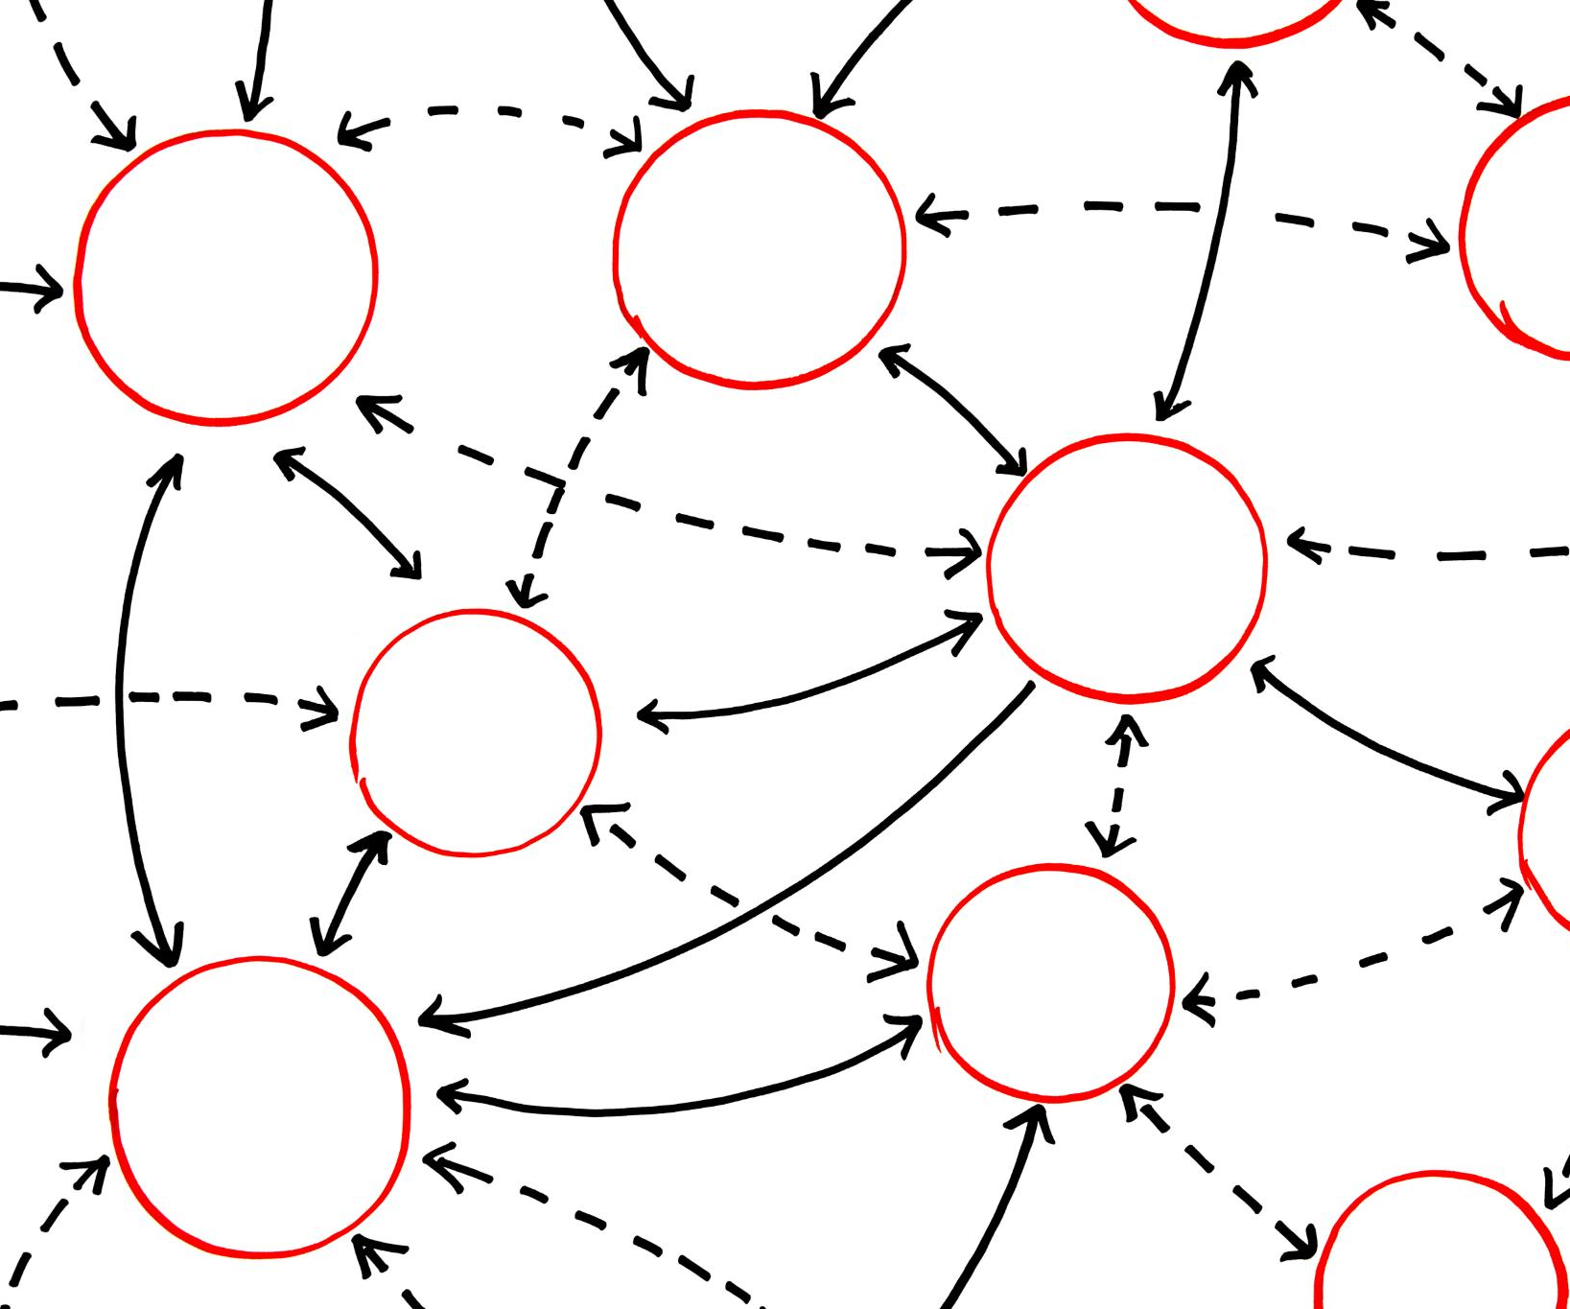
RAG Agent Architecture
Retrieval Module Function
The retrieval module fetches relevant documents to provide context for generation.
Generative Module Role
The generative module produces output conditioned on the retrieved data for accuracy.
Notes:
--- The architecture integrates a retrieval module that fetches relevant documents and a generative module that conditions output on retrieved data. Image source: Microsoft 365 content library

Slide 21
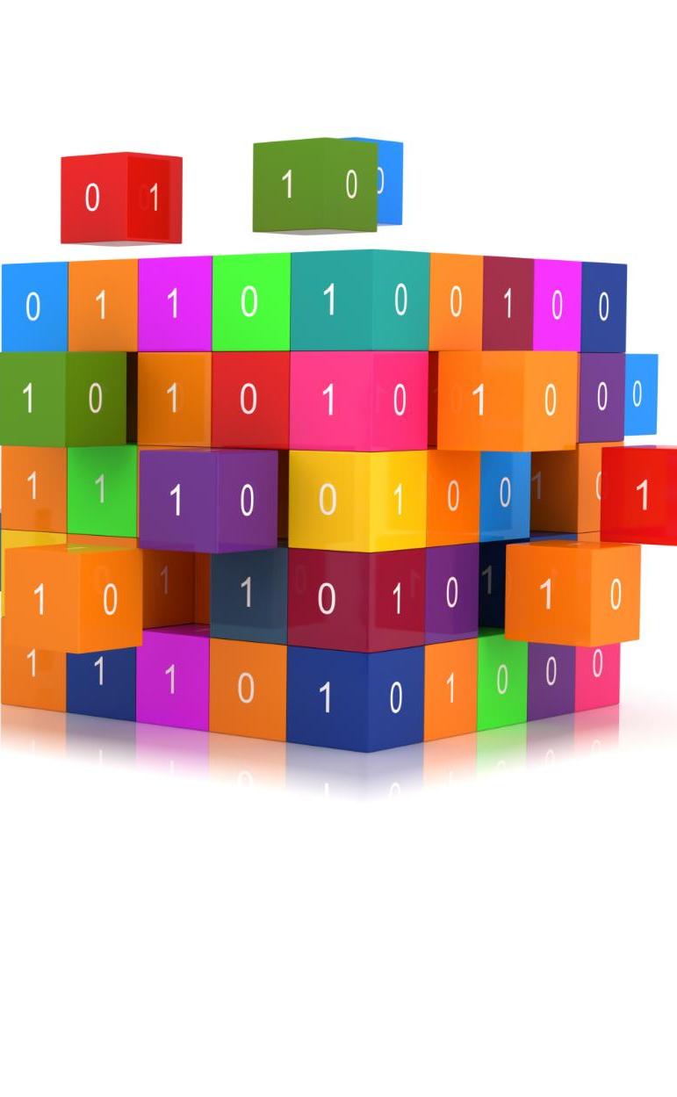
Workflow Steps
Query Processing
The initial step where the system analyzes and interprets the user's query for further processing.
Document Retrieval
The system searches and retrieves relevant documents or data based on the query input.
Contextual Generation
Generating relevant and context-aware responses or content based on retrieved data and query context.
Output Delivery
Delivering the generated output or responses back to the user effectively and clearly.
Notes:
--- Step-by-step processes include query processing, document retrieval, contextual generation, and output delivery to the user. Image source: Microsoft 365 content library

Slide 22
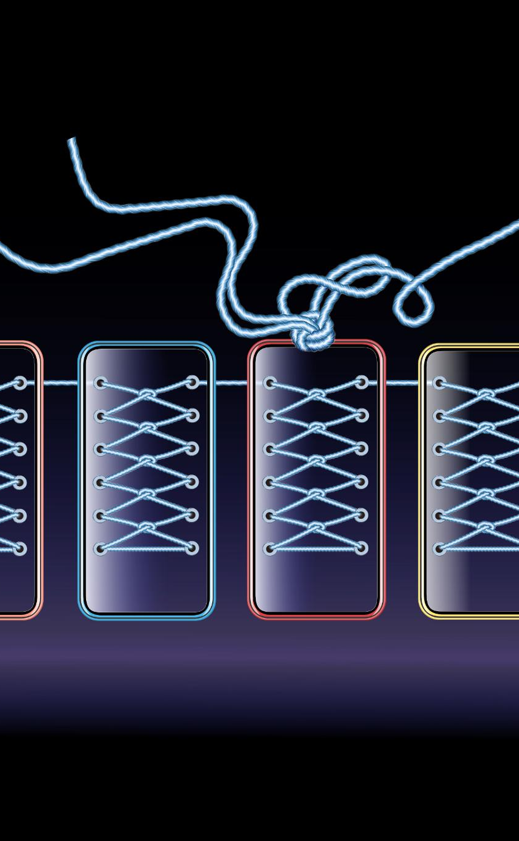
Critical Pipeline Components
Retriever Component
The retriever gathers relevant data efficiently from the index database to support generation.
Generator Component
The generator creates content based on retrieved information to form meaningful outputs.
Index Database
The index database stores and organizes data to enable quick and accurate retrieval.
Response Synthesizer
The response synthesizer combines generated content into cohesive and enhanced outputs.
Notes:
--- Key components are the retriever, generator, index database, and response synthesizer working cohesively to produce enhanced outputs. Image source: Microsoft 365 content library

Slide 23
Slide 6: Improving Retrieval
Notes:
This section discusses techniques to enhance the retrieval stage of RAG agents, improving relevance and efficiency.

Slide 24

Query Reformulation Strategies
Query Expansion
Adding related terms to the original query broadens search scope and improves document retrieval accuracy.
Paraphrasing Queries
Rewriting queries in different ways captures varied user intents and enhances retrieval effectiveness.
Relevance Feedback
User feedback on results refines queries iteratively to better match information needs.
Notes:
--- Techniques such as query expansion, paraphrasing, and relevance feedback help refine queries to retrieve better documents. Image source: Microsoft 365 content library

Slide 25

Document Ranking and Caching
Ranking Algorithms
Effective ranking algorithms prioritize relevant documents to enhance search result quality and user satisfaction.
Query Caching
Caching frequent queries reduces retrieval time and speeds up system response for common searches.
Notes:
--- Implementing effective ranking algorithms and caching frequent queries accelerate retrieval and improve response quality. Image source: Microsoft 365 content library

Slide 26

Boosting Retrieval Accuracy
Semantic Search Integration
Incorporating semantic search improves understanding of user intent beyond exact keywords.
Keyword Matching
Traditional keyword matching ensures relevance by matching exact terms in queries and documents.
User Interaction Data
Leveraging user data like click patterns and feedback refines search accuracy over time.
Notes:
--- Combining semantic search with traditional keyword matching and leveraging user interaction data can significantly enhance accuracy. Image source: Microsoft 365 content library

Slide 27
Slide 7: Enhancing Generation
Notes:
We explore advanced generation techniques such as beam search and sampling methods to improve the quality and coherence of outputs.

Slide 28

Beam Search Techniques
Parallel Candidate Exploration
Beam search evaluates several candidate sequences simultaneously to improve search efficiency.
Balancing Exploration and Exploitation
The technique maintains a balance between exploring new sequences and exploiting promising ones for optimal results.
Optimal Text Generation
Beam search aims to generate the most optimal text sequences by leveraging its search strategy.
Notes:
--- Beam search explores multiple candidate sequences in parallel, balancing exploration and exploitation to generate optimal text. Image source: Microsoft 365 content library

Slide 29

Nucleus Sampling and Top-K/P
Controlled Randomness
Nucleus and top-k sampling methods introduce controlled randomness to improve text diversity.
Enhanced Text Diversity
These sampling techniques enable models to generate more diverse and natural-sounding text.
Notes:
--- Sampling methods like nucleus (top-p) and top-k introduce controlled randomness, enabling more diverse and natural generated text. Image source: Microsoft 365 content library

Slide 30

Generating Coherent Outputs
Generation Techniques
Utilizing various generation methods improves the quality and fluency of outputs produced by AI systems.
Context Awareness
Incorporating context helps maintain relevance and logical consistency in generated responses.
Coherent Response
Combining generation and context results in fluent and logically sound outputs.
Notes:
--- Combining generation techniques with context awareness ensures responses are fluent, relevant, and logically consistent. Image source: Microsoft 365 content library

Slide 31
Slide 8: Grounding AI Responses
Notes:
This section covers integrating external knowledge sources and commonsense reasoning to ground AI-generated responses robustly.

Slide 32

Integrating External Knowledge Bases
Connection to Knowledge Bases
Integrating AI agents with structured knowledge bases enhances factual accuracy and reliability in responses.
Enriched Response Content
Access to external databases enriches AI-generated content with detailed and supported information.
Notes:
--- Linking AI agents to structured knowledge bases and databases provides factual support and enriches response content. Image source: Microsoft 365 content library

Slide 33

Commonsense Reasoning
Understanding Implicit Context
Commonsense reasoning enables AI to grasp implicit context beyond explicit data inputs.
Producing Sensible Outputs
Models with commonsense reasoning generate more relevant and logical AI responses.
Notes:
--- Incorporating commonsense reasoning models helps AI understand implicit context and produce sensible outputs. Image source: Microsoft 365 content library

Slide 34

Ensuring Robust Grounding
Cross-Verification Techniques
Cross-verification ensures information accuracy by comparing multiple data sources before finalizing responses.
Real-Time Data Incorporation
Incorporating real-time data helps keep responses up-to-date and enhances factual reliability.
Notes:
--- Methods such as cross-verification and real-time data incorporation improve the reliability and factual accuracy of responses. Image source: Microsoft 365 content library

Slide 35
Slide 9: Importance of Veracity
Notes:
We emphasize the critical importance of maintaining truthful and coherent AI responses, with mechanisms to verify and promote veracity.

Slide 36

Ensuring Coherence in Responses
Logical Consistency
Ensuring responses follow a clear and rational progression enhances user understanding and trust.
Avoiding Contradictions
Eliminating conflicting information within responses improves clarity and reliability of AI outputs.
Notes:
--- Maintaining logical consistency and avoiding contradictory information increases trust and usability of AI-generated text. Image source: Microsoft 365 content library

Slide 37

Promoting Truthfulness
Grounding in Factual Data
Using reliable and verified data sources ensures AI outputs remain accurate and trustworthy.
Model Calibration
Adjusting AI models to reduce bias and error improves the truthfulness of outputs.
Notes:
--- Strategies such as grounding in factual data and model calibration help promote truthful AI outputs. Image source: Microsoft 365 content library

Slide 38

Veracity Checks
Automated Verification Tools
Automated tools analyze data to quickly identify inaccuracies and verify content authenticity.
Human-in-the-Loop Approach
Human experts review and validate content to ensure higher accuracy and contextual understanding.
Notes:
--- Automated tools and human-in-the-loop approaches can be used to verify the truthfulness of generated content. Image source: Microsoft 365 content library

Slide 39
Slide 10: Advanced Topics in RAG
Notes:
This final section explores advanced techniques including multi-turn dialogue handling, active learning, and reinforcement learning to adapt RAG agents.

Slide 40

Handling Multi-Turn Conversations
Context Management
Maintaining conversation context ensures relevant and coherent responses across multiple turns.
State Handling
Effective state tracking allows the system to remember user inputs and preferences during interaction.
Improved User Experience
Well-managed multi-turn conversations enhance the naturalness and satisfaction of user interactions.
Notes:
--- Techniques to manage context and state across multiple conversational turns improve interaction quality and user experience. Image source: Microsoft 365 content library

Slide 41

Active Learning Integration
Selective Querying
Active learning enables models to choose specific data points for annotation, improving efficiency.
Performance Enhancement
This approach enhances model performance by focusing on the most informative samples for training.
Cost Reduction
Reducing the number of annotations lowers labeling costs and resource usage significantly.
Notes:
--- Active learning allows models to selectively query for annotations, enhancing performance while reducing labeling costs. Image source: Microsoft 365 content library

Slide 42
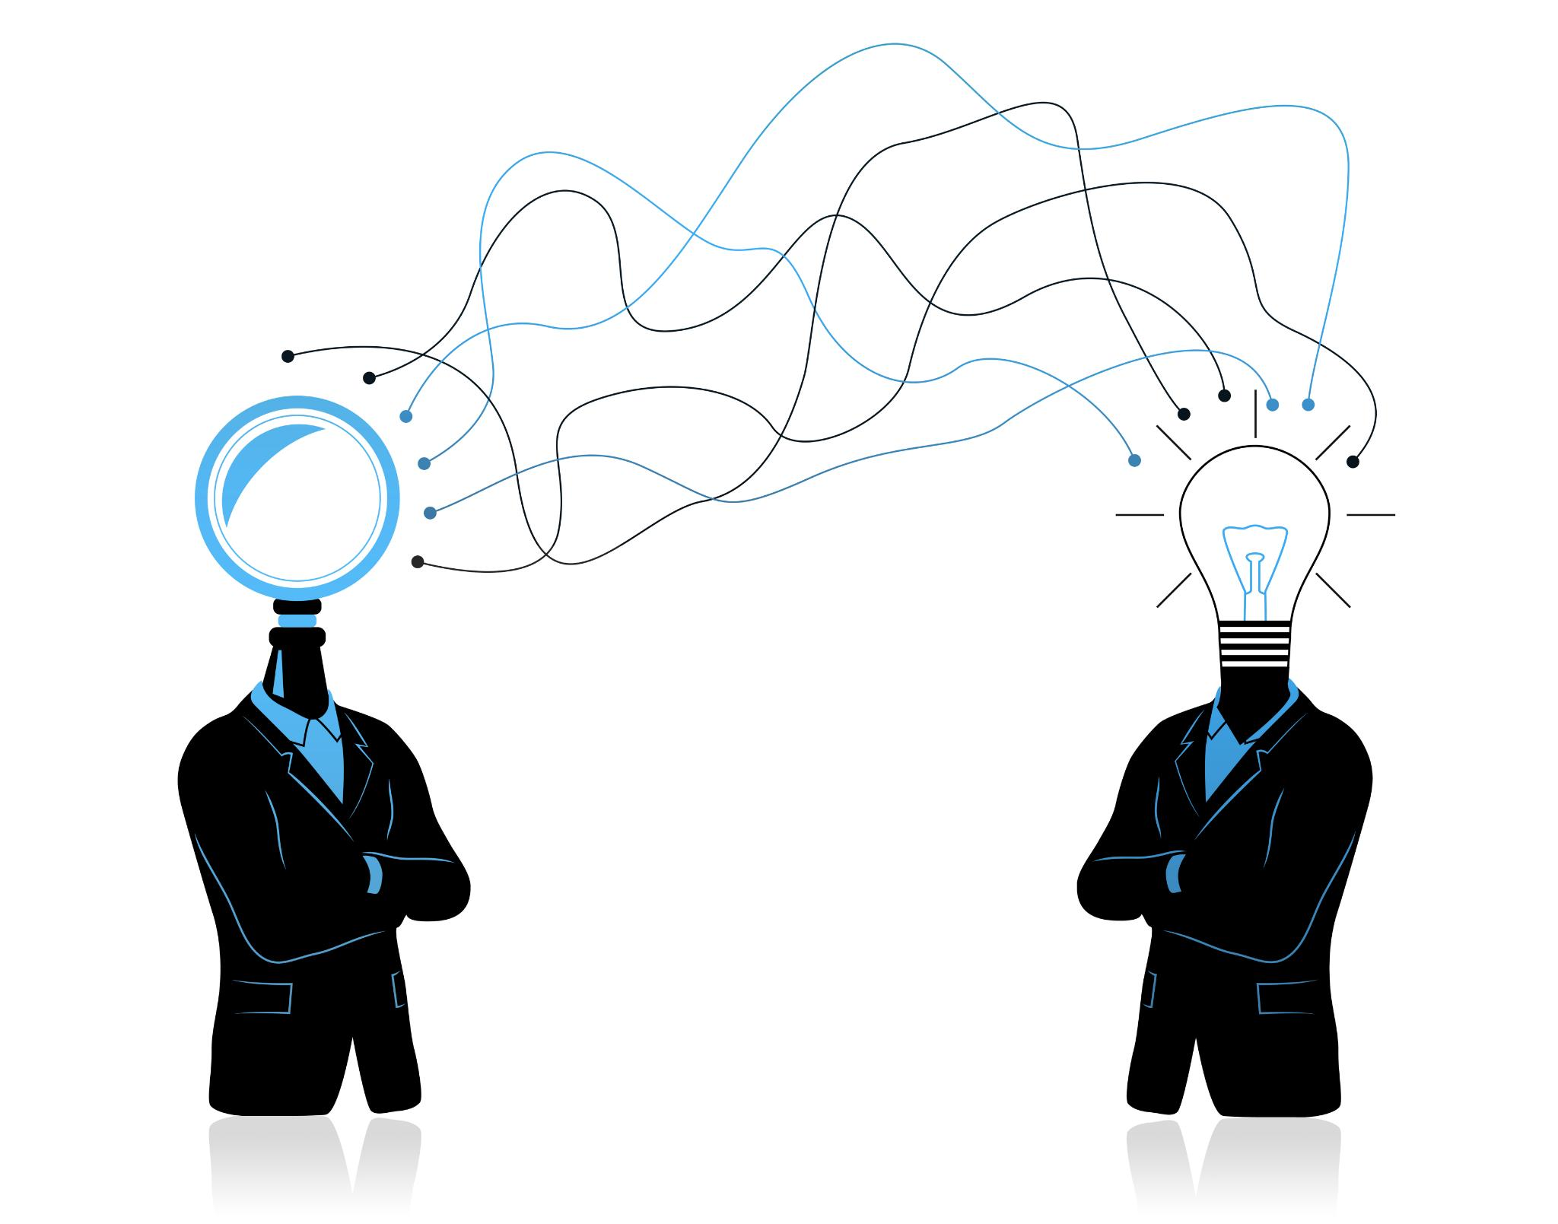
Reinforcement Learning for Adaptation
Dynamic Adaptation
Reinforcement learning allows agents to change behavior dynamically in response to environmental feedback.
Performance Optimization
Agents optimize their long-term performance by learning from past actions and rewards.
Notes:
--- Reinforcement learning techniques enable RAG agents to adapt dynamically based on feedback, optimizing long-term performance. Image source: Microsoft 365 content library

Slide 43
Conclusion
Structured Learning Pathway
The course offers a clear pathway to develop RAG agents using advanced large language models.
Hardware Empowerment
NVIDIA hardware provides essential computing power for building efficient AI applications.
Integration of Retrieval and Generation
The course equips learners to integrate retrieval-based methods with generative AI effectively.
Notes:
This course provides a structured pathway to build and enhance RAG agents leveraging large language models. With NVIDIA hardware and modern frameworks, learners are equipped to develop cutting-edge AI applications that integrate retrieval and generation effectively.

